Slide 1
E Commerce Purchase
preduction
Prepared by :
Awatif Ali Alshehri

Slide 2




Overview
Introduction
Data Cleaning
Exploratory Data Analysis
Modeling

Slide 3

Introduction
Artificial intelligence is used in e-commerce to provide better product management and sales support for any ecommerce company. By using AI, it is much easier to understand the needs of the customers and to offer an improved customer experience. It also helps ecommerce companies to increase the revenue and profit significantly by gathering crucial pieces of information about their customers. This can also help anticipate what consumers may want in the future.
E-commerce
Accept
Reject

Slide 4


Dataset
F
rom
Kaggle
8 columns
Data shape
This data set contains all the transactions occurring between 12/2010 and 12/2011 for a UK-based and registered non-store online retail.
542k
rows

Slide 5

Data Cleaning
Step 4
Step 1
Insert a column called `TotalPrice` which equils to UnitPrice times Quantity
Change the column names to clearer names
4
1
Step 3
3
2
Step 2
Insert two columns called ‘date’ and ‘year’ from column ‘InvoiceDate’
Drop rows that contain zero or negative values in UnitPrice

Slide 6
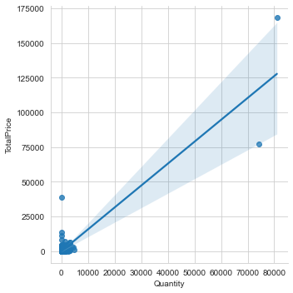
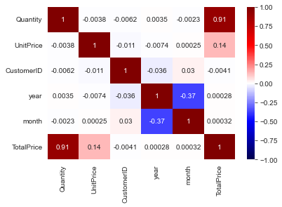
Exploratory Data Analysis
Draw the relationship between the Quantity and Total Price
What is the correlation between the features

Slide 7
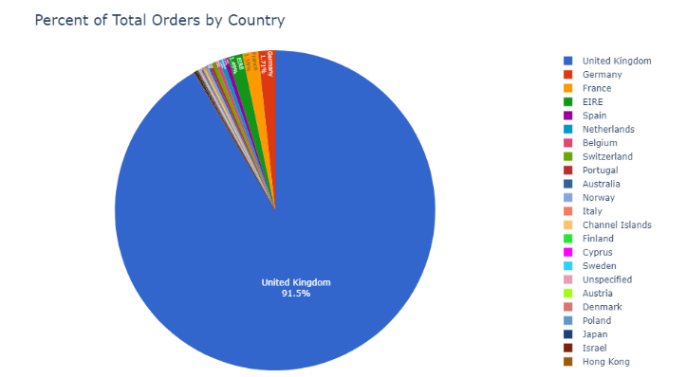
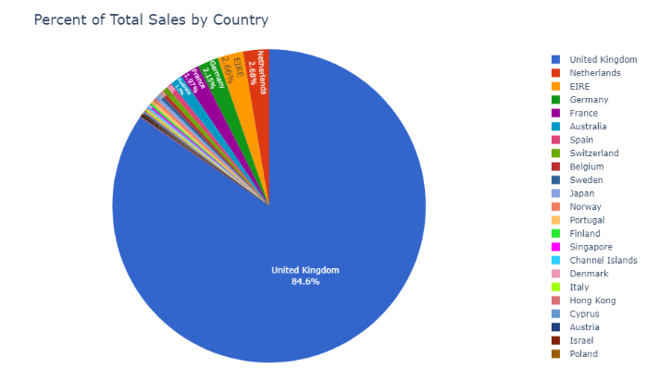
Exploratory Data Analysis
What are the number of Orders for each Country?
What is the Sales trend for Each Country?

Slide 8
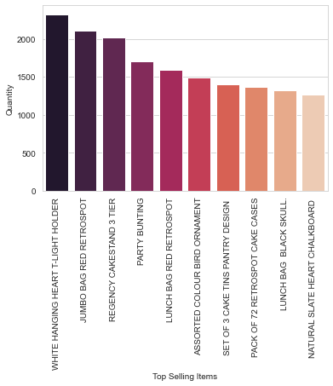
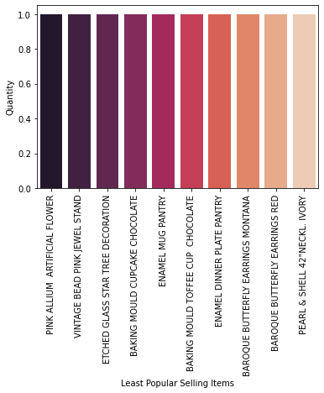
Exploratory Data Analysis
What are the most popular ten items?
What are the least popular ten items?

Slide 9
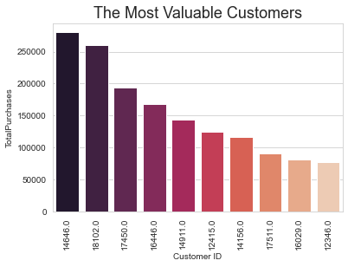
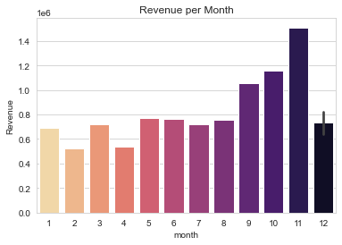
Exploratory Data Analysis
Who are the ten most valuable customers?
How much is the revenue for each month?

Slide 10
Exploratory Data Analysis (RFM analysis)
A
B
C
Monetary
Frequency
Recency
According to the total purchase.
According to the total number of orders
According to the most recent purchase

Slide 11

Exploratory Data Analysis (RFM analysis)
Churned Customers
Best Customers
When RFMScore = 111
444
When the RFMScore = 444
10
456
Almost Churned
Customers
Customers at risk
of churning
70
872
When RFMScore = 144
When RFMScore = 244
1085
Loyal Customers
Big Spenders
When Freq_Quartile = 4
When Mone_Quartile = 4

Slide 12
Machine Learning Model
A
B
C
C
D
KMeans
MiniBatch KMeans
DBSCAN
Spectral Clustering
Mean Shift

Slide 13
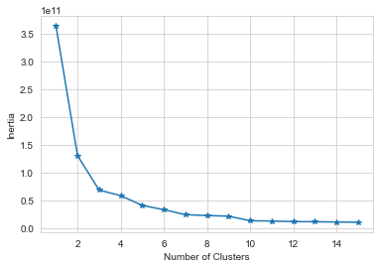
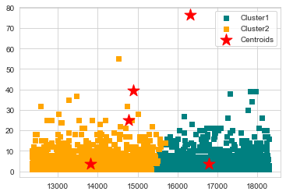
Kmeans
The Kmeans Clusters
Result of For loop of Kmeans Scores

Slide 14
FREE E-COMMERCE TEMPLATE PRESENTATION
0.33
KMeans
0.29
MiniBatch KMeans
Clustruing Algorithms Scores
0.14
DBSCAN
0.32
Spectral Clustering
0.43
Mean Shift

Slide 15
Conclusion
The Mean Shift with n_clusters=3 was the best performing model, based on Silloutte score
Increase marketing campaign by the end of the year
Sell products as packages to increase the profit of the company
Conclusion

Slide 16

Tools
NumPy
4
1
Seaborn
Pandas
5
2
Scikit-learn
Matplotlip
6
3
Datetime

Slide 17
Any Questions?

